Slide 1
L06.02 Depth-First-Search (DFS), Topological sort
50.004 Introduction to Algorithm
Dr. Simon LUI
ISTD, SUTD

Slide 2
1. DFS

Slide 3
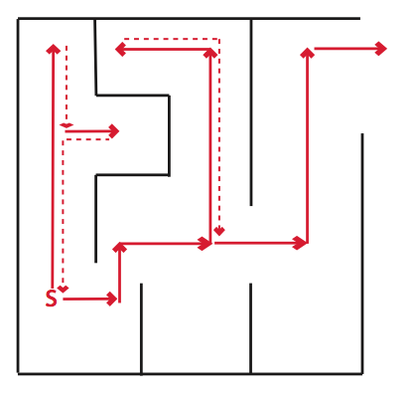

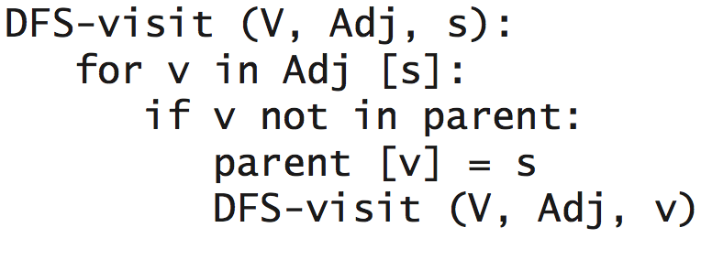
Depth-first search
Idea: Similar to exploring a maze
follow path until you get stuck
backtrack along breadcrumbs
recursively explore
The DFS Algorithm

Slide 4
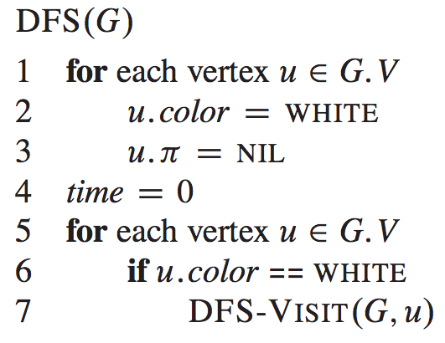
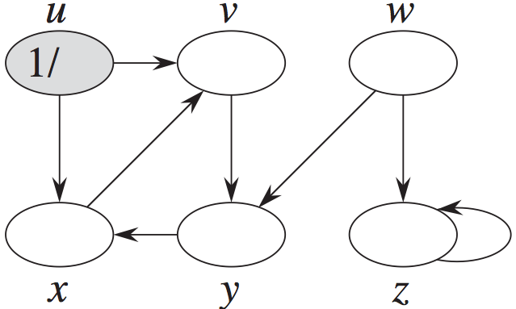
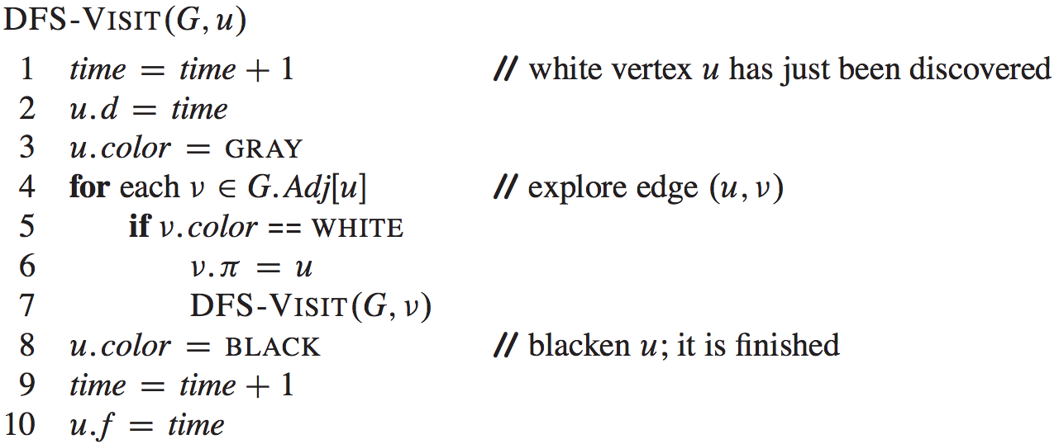
The DFS algorithm
(using color and timestamp)
timestamps

Slide 5
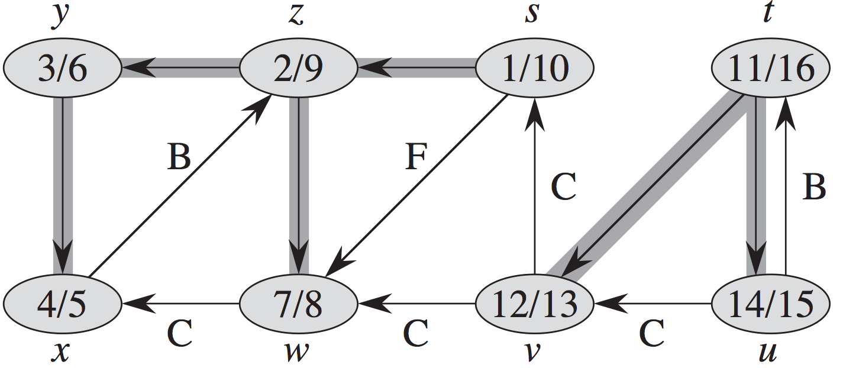
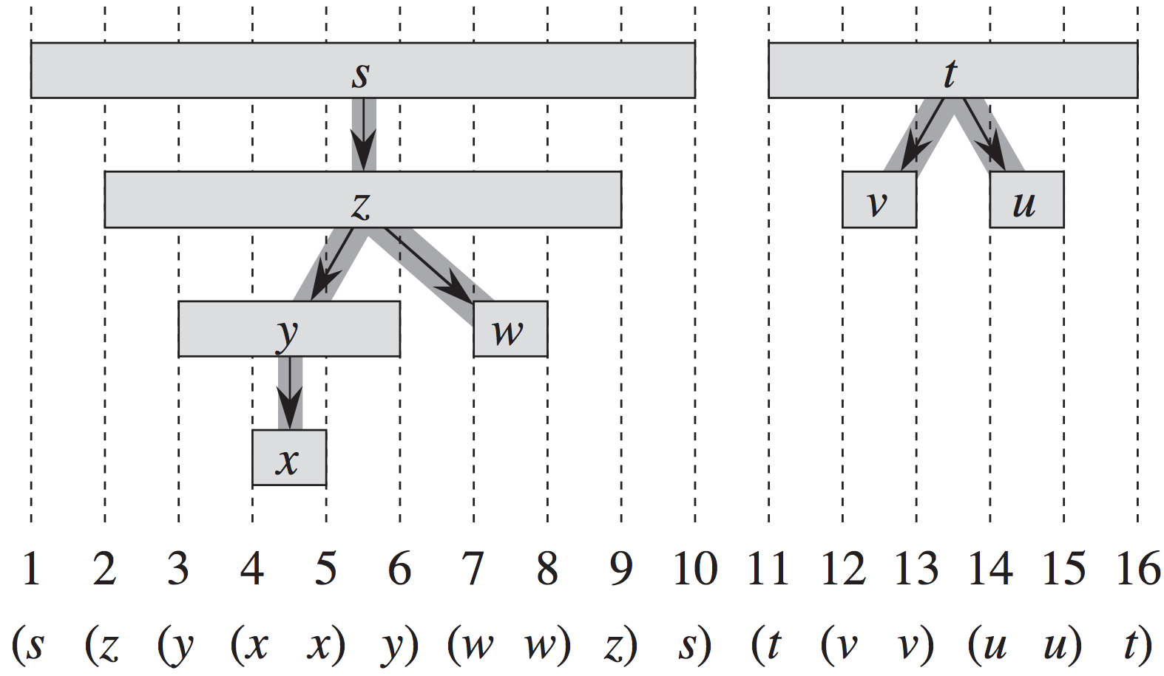
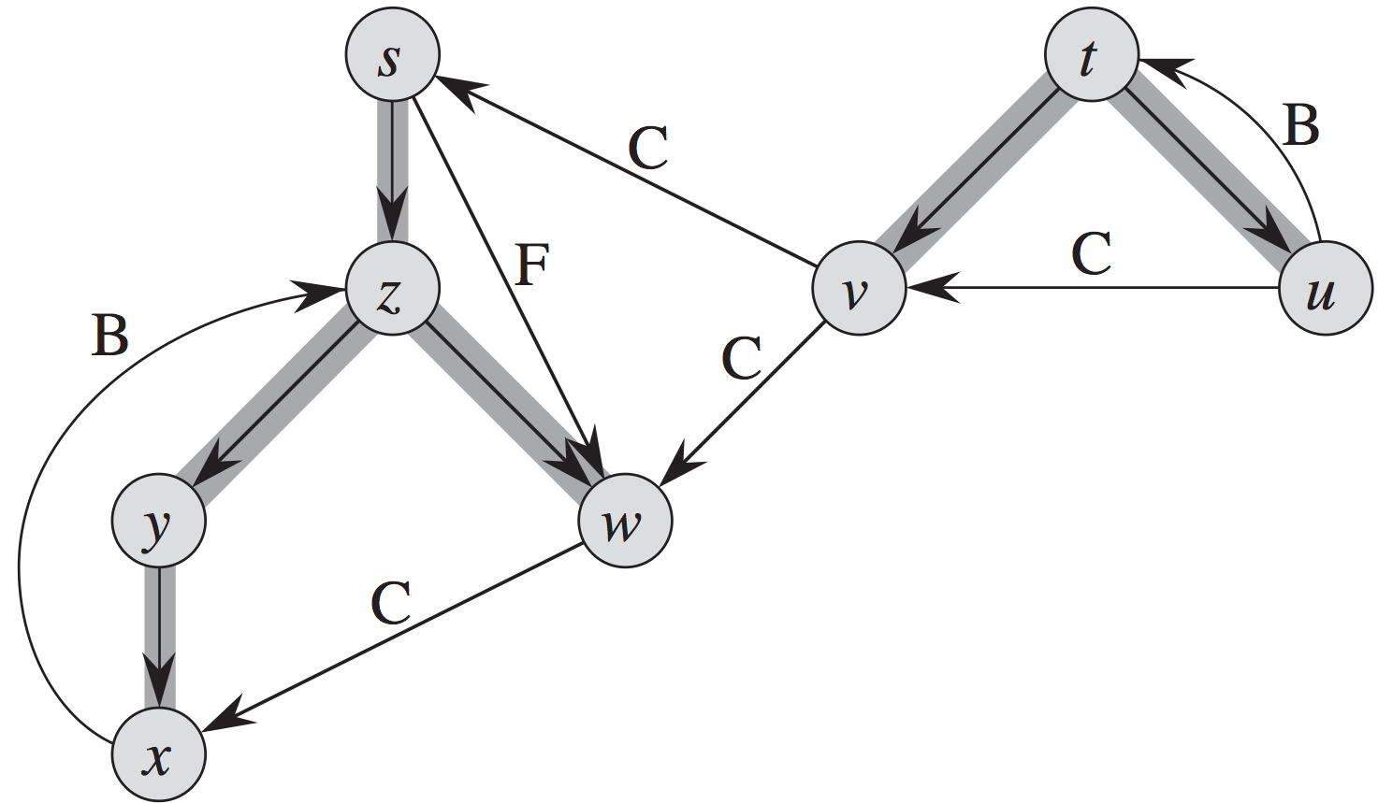
Properties of DFS
DF forest
>1 trees

Slide 6
Cycle detection
Graph G has a cycle iff DFS has a back edge
Directed Acyclic Graph = DAG

Slide 7
Topological sort
Topological sort of a DAG G=(V,E)
Run DFS(G), compute finishing times of nodes
Output the nodes in decreasing order of finishing times

Slide 8
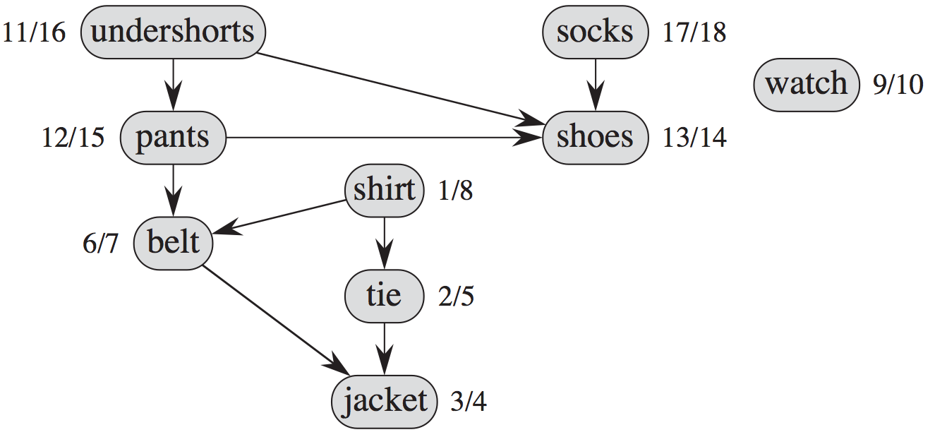
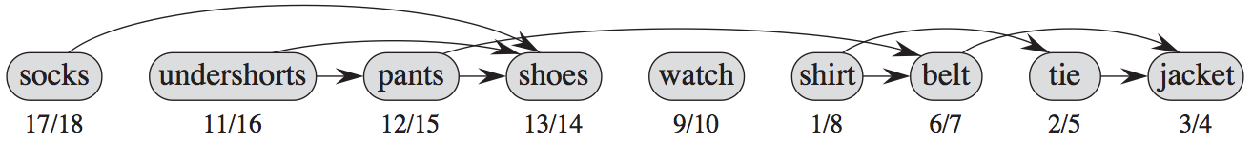
The Graph – relationship between clothing procedures
The Topological sort – a workable sequence of clothing

Slide 9
s
e
a
TOPOLOGICAL
SORT
d
b
c

Slide 10
s
s
e
a
d
b
c

Slide 11
s
This is the first tree edge
s
e
a
a
d
b
c

Slide 12
s
s < a
s
e
a
a
d
b
c

Slide 13
s
s
e
a
a
b
a < b
d
b
c

Slide 14
s
s
e
a
a
b
d
b
c
b < c
c

Slide 15
s
s
e
a
a
b
d
b
c
d
c < d
c

Slide 16
s
s
This is a back edge.
We don’t follow it because the grey node b is on the stack.
e
a
a
b
d
b
c
d
c

Slide 17
s
A back edge connects from a grey node to another grey node.
s
e
a
a
b
d
b
c
d
c

Slide 18
s
s
e
a
a
b
d
b
c
d
c

Slide 19
s
s
e
a
a
b
d
b
c
d
c

Slide 20
s
s
e
a
a
b
d
b
c
d
c

Slide 21
s
This is a forward edge.
We don’t follow it because d is coloured black.
s
e
a
a
b
d
b
c
d
c

Slide 22
A forward edge connects a grey node to a black node.
s
s
e
a
a
b
d
b
c
d
c

Slide 23
s
s
e
a
a
b
d
b
c
d
c

Slide 24
s
s
e
a
a
e
b
d
b
c
d
c

Slide 25
s
This is a cross edge.
It connects between two different subtrees.
s
e
a
a
e
b
d
b
c
d
c

Slide 26
Both cross edges and forward edges connect from a grey node to a black one.
s
s
e
a
a
e
b
d
b
c
d
c

Slide 27
s
s
e
a
a
e
b
d
b
c
d
c

Slide 28
s
s
e
a
a
e
b
d
b
c
d
c
This is the DFS tree.

Slide 29
s
a
e
b
c
d
We sort the elements based on their finish times.
d
c
b
a
e
s

Slide 30
DFS example
Start / end times
Classification of edges

Slide 31
u
v
w
x
y
z
Time: 0

Slide 32
We begin at u and mark its start time: 1.
u
v
w
1/
x
y
z
Time: 1

Slide 33
u
v
w
1/
2/
This is a tree edge.
x
y
z
Time: 2

Slide 34
u
v
w
1/
2/
3/
x
y
z
Time: 3

Slide 35
u
v
w
1/
2/
4/
3/
x
y
z
Time: 4

Slide 36
u
v
w
1/
2/
This is a back edge
4/
3/
x
y
z
Time: 5

Slide 37
u
v
w
1/
2/
x finished at time 5
4/5
3/
x
y
z
Time: 5

Slide 38
u
v
w
1/
2/
4/5
3/6
x
y
z
Time: 6

Slide 39
u
v
w
1/
2/7
4/5
3/6
x
y
z
Time: 7

Slide 40
u
v
w
1/
2/7
This is a forward edge.
4/5
3/6
x
y
z
Time: 8

Slide 41
u
v
w
1/8
2/7
4/5
3/6
x
y
z
Time: 8

Slide 42
u
v
w
1/8
2/7
9/
4/5
3/6
x
y
z
Time: 9

Slide 43
u
v
w
1/8
2/7
9/
This is a cross edge.
4/5
3/6
x
y
z
Time: 9

Slide 44
u
v
w
1/8
2/7
9/
4/5
3/6
10/
x
y
z
Time: 10

Slide 45
u
v
w
1/8
2/7
9/
4/5
3/6
10/
x
y
z
Time: 10

Slide 46
u
v
w
1/8
2/7
9/
4/5
3/6
10/11
x
y
z
Time: 11

Slide 47
u
v
w
1/8
2/7
9/12
4/5
3/6
10/11
x
y
z
Time: 12

Slide 48
u
v
w
1/8
2/7
9/12
4/5
3/6
10/11
x
y
z
The search is now complete.
Time: 12

Slide 49
With only tree edges visible, we can see that this DFS path has two trees.
u
v
w
1/8
2/7
9/12
4/5
3/6
10/11
x
y
z

Slide 50
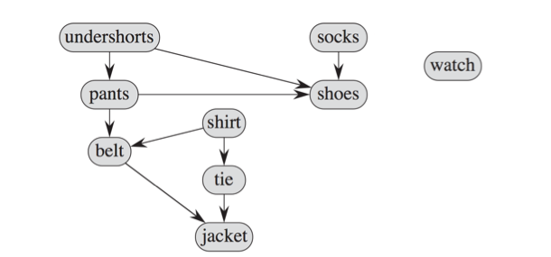
Background of Exercise 1
“I don’t want to wear socks first! I want something else first!
… ok … let’s use it as an exercise

Slide 51
Exercise 1
1) Start a DFS from undershorts / socks / watch
2) Do a topological sort with that DFS

Slide 53
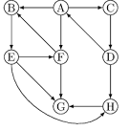
Exercise 2
Start from A, construct the DFS of the follow.
Do a Topological search

Slide 54
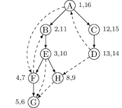
Exercise 2 answer
One POSSIBLE answer of the DFS tree traversal:
One POSSIBLE answer of the topological sort:
A C D B E H F G

